Slide 1

MANUFACTURING ANALYSIS PROJECT
Presented by – Group 4
Muddapolu Santhosh Kumar
Putturu Roopesh
Fathima Ali
Shreyas Reddy D
Bharath S S
Sanjana V
Rajashree Gujjula

Slide 2






Agenda
Goal & objective
Excel
MySQL
Tableau
PowerBI

Slide 3
Purpose: In this capstone project, we built an end-to-end manufacturing analytics solution: raw production data was cleaned in Excel and loaded into a SQL database schema with views to compute KPIs (production volume, defect rate, machine utilization, on-time delivery). Interactive dashboards were developed in Tableau and Power BI to turn these KPIs into actionable intelligence. The goal is to demonstrate how technical skills (SQL data modeling, BI tools) and data integration can drive business value by boosting operational efficiency, product quality, and real-time visibility on the shop floor
Agenda
Goal & objective
Excel
Agenda
Outline the presentation flow:
Project Objectives & Data Overview
Data Preparation (Excel)
Week-by-week Implementation (Excel, Tableau/SQL, Power BI)
Data Modeling & SQL Details
KPI Dashboards & Visualizations
Key Insights & Business Impact
Project Timeline (4-week plan)
MySQL
Tableau
PowerBI

Slide 4
Agenda
Goal & objective
Goals and Objectives:
Enhance efficiency and reduce lead times.
Integrate sustainable practices throughout the supply chain.
Adopt innovative technologies to modernize operations.
Improve product quality and consistency.
Strengthen market competitiveness.
Prioritize worker welfare and safety.
Ensure customer satisfaction.
Drive sustainable growth and profitability.
Excel
MySQL
Tableau
PowerBI

Slide 5
Agenda
KPI Implementation in Excel
Define KPIs: Calculate preliminary metrics such as Production Volume (total units/time) and Yield (good units/total units). Production volume “measures how many units are manufactured during a time frame
Excel Analysis: Use formulas (SUM, AVERAGE) and PivotTables to compute these KPIs by line, shift, or product.
Charts: Create initial visualizations (e.g. line chart for output over time, bar chart comparing lines).
Narration: “In Week 1 we set up core metrics in Excel. This let us quickly see trends – for example, daily output and defect rates – before moving to more robust tools.”
Goal & objective
Excel
MySQL
Tableau
PowerBI

Slide 6
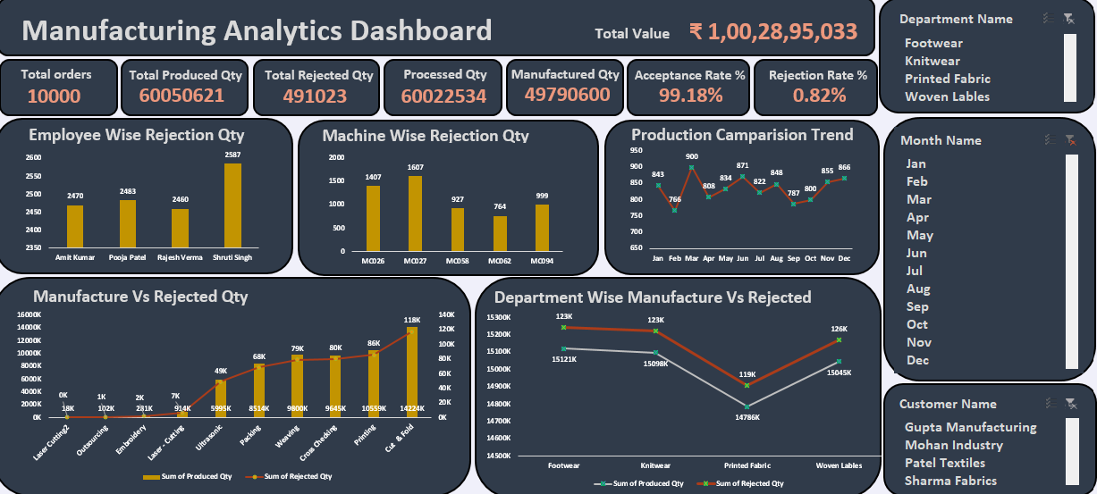
Agenda
KPI Implementation in Excel Dashboard
Goal & objective
Excel
MySQL
Tableau
PowerBI

Slide 7
Agenda
Data Modeling & SQL Implementation
Star Schema Design: We adopted a dimensional model: one central Production Facts table (with metrics per batch or time interval) and several Dimension tables (Date, Product, Machine, Shift). This was designed before building to ensure clean relationships.
Primary/Foreign Keys: Define keys (e.g. production.fact_date_key → date.key) and indexes. This enforces referential integrity and speeds joins.
SQL Joins & Views: Write SQL queries to join fact and dimensions. For example, join production with downtime logs to calculate total downtime by machine. Create views for each KPI (e.g. vw_KPI_ProductionRate). SQL is used for “transforming, refining, and cleaning” data in this phase.
Goal & objective
Excel
MySQL
Tableau
PowerBI

Slide 8
Agenda
SQL Database Setup & Tableau
SQL Schema: Design a relational schema (fact table for production events, dimension tables for date, product, machine, etc.) – schema should be planned before building for data integrity Create tables and import cleaned data.
Data Loading: Use SQL INSERT/ETL to populate tables. Index key fields (e.g. date_id, machine_id) for performance.
Tableau Connection: Connect Tableau to the SQL database. Build data source extracts if needed. Begin creating dashboards: drag-and-drop charts for our KPIs.
SQL for BI: “SQL is the fundamental dialect through which BI platforms communicate with databases”. We write queries/views to feed Tableau (e.g. total output per month, average quality per machine).
Goal & objective
Excel
MySQL
Tableau
PowerBI

Slide 9
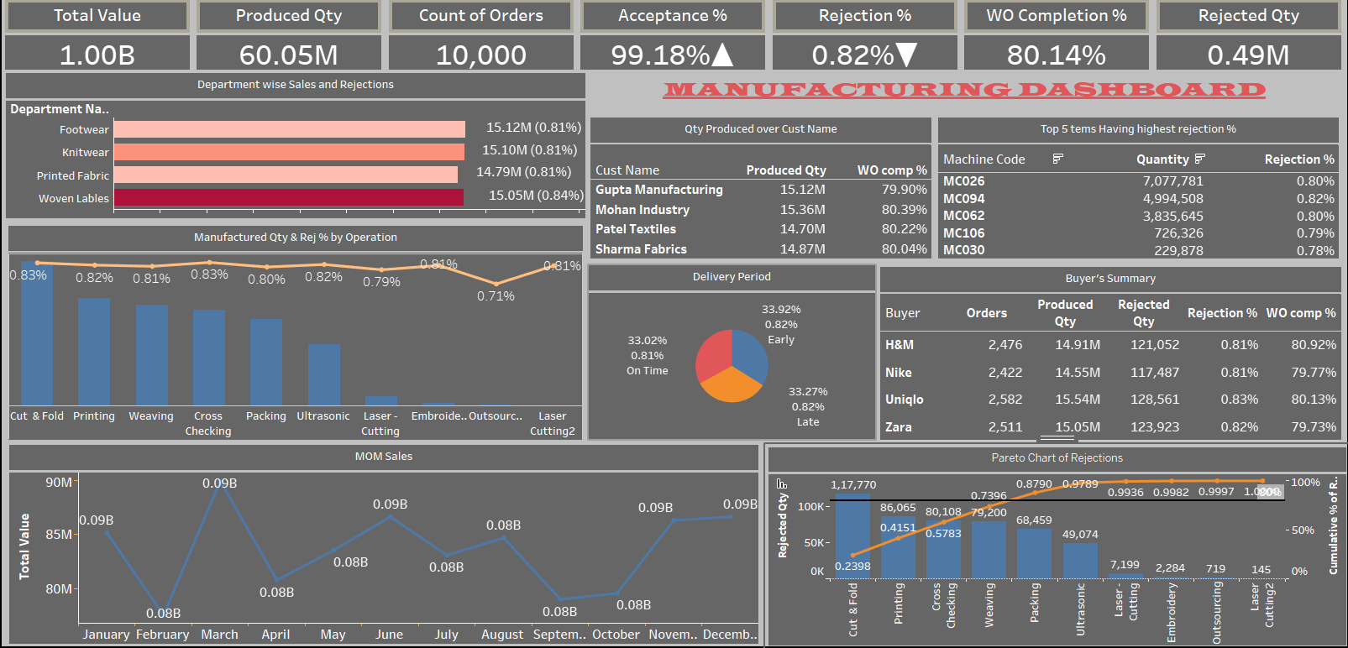
Agenda
Tableau Dashboard.
Goal & objective
Excel
MySQL
Tableau
PowerBI

Slide 10
Agenda
Advanced Analytics with SQL & Power BI
SQL Refinement: Enhance queries and views: add joins (e.g. production ↔ downtime tables) and aggregations. Use window functions or GROUP BY for complex metrics.
Power BI Reports: Load the same dataset into Power BI. Recreate and extend dashboards (multiple pages, interactive slicers, KPI cards). Define DAX measures if needed (e.g. year-to-date throughput).
Interactivity: Focus on filters (e.g. time period, product line) and drill-down (details on individual batches). Each interaction generates new SQL queries for up-to-date results.
Narration: “In Week 3 we refined our analytics. Power BI allowed us to add visual polish (custom visuals, KPI indicators). Behind the scenes, each filter click triggers SQL to fetch fresh data, keeping the dashboards live.”
Goal & objective
Excel
MySQL
Tableau
PowerBI

Slide 11
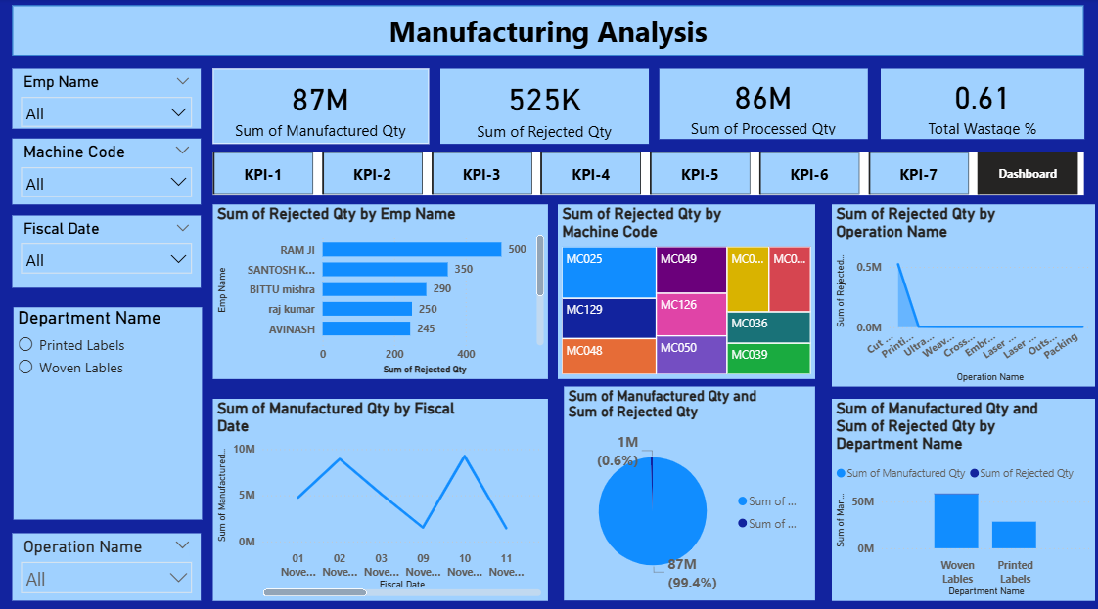
Agenda
Power BI Dashboard
Goal & objective
Excel
MySQL
Tableau
PowerBI

Slide 12
1.00B Total Value
Indicates the overall production value achieved.
60.05M Units Produced Quantity
Represents the total manufactured output.
99.18% ✅ Acceptance %
Shows that the majority of products passed quality checks.
10,000 Count of Orders
Reflects the total customer demand fulfilled.
0.82% ❌ Rejection %
Demonstrates strong process control with minimal defects.
80.14% 📉 Work Order Completion %
Indicates orders completed vs. orders planned.
0.49M UnitsRejected Quantity
Total volume of defective or rejected products.

Slide 13
Business Impact:
Provided real-time visibility into key production metrics through interactive BI dashboards.
Improved accuracy of decision-making with KPIs such as production volume, rejection rate, machine utilization, and on-time delivery.
Identified operational bottlenecks and quality issues, enabling targeted actions to reduce downtime and defects.
Supported alignment of operations with business goals by tracking efficiency, quality, and cost metrics.
Showcased the value of integrated data systems in driving continuous improvement and competitive advantage in manufacturing.

Slide 14
Conclusion:
Successfully transformed raw manufacturing data into actionable insights using an end-to-end analytics pipeline.
Utilized Excel for data cleaning, SQL for database design and KPI calculation, and Tableau/Power BI for interactive dashboards.
Demonstrated how technical skills in data modeling, querying, and visualization can address real-world manufacturing challenges.
Enhanced understanding of integrating multiple tools to track efficiency, quality, and productivity.
Delivered practical dashboards that support informed decision-making and performance monitoring.

Slide 15
THANK YOU

